Slide 1
Responsive Design
-Sakshi Sharma
-Himanshi Gera

Slide 2
What is
Web Design ??
Why is it important?

Slide 3
Web design is the process of creating websites.
It’s the presentation of content on web pages which can be accessed on a web browser.
Elements of Web Design:
Layout: Arrangement of ads, graphics, text, etc.
Color: Choice of colors. Depends on purpose and clientele.
Graphics: Include logos, photos, icons, etc.
Fonts: Enhance the design. Make text appealing and readable.
Content: Quality content to retain the users. SEO friendly.
The layout, structure and appearance of the webpage are created using HTML and CSS.
HTML tags define content of each page.
CSS defines the look and feel of the page.

Slide 4
Importance of Web Design
Attract more customers.
Improve the customer conversion to business.
Improve the brand awareness and uniformity.

Slide 5
Types of Web Designs
There are 4 major types of Web designs:
Static or Fixed
Fluid or Liquid
Adaptive
Responsive

Slide 6
Static or Fixed Design
Fixed web pages have a set width (in pixels) that won't alter when the browser is resized.
The ‘container’ of the website is programmed to not move.
The width of 960px is the most widely used size for fixed-layout websites.
Drawbacks:-
The content is hard to view on smaller devices due to:
The need of scrolling horizontally.
Or pinch and expand to zoom, etc.
Having a static website is a risk to lose a big part of the audience.
Notes:
Example Link For Static Design:- https://codepen.io/nickpettit/full/AyaGb

Slide 7
Fluid or Liquid Design
The layout here resizes as the window size is changed.
Fluid pages keeps the same proportions of the page regardless of the device it is open on.
The columns containing the content are built using percentages rather that fixed widths.
The columns increase or decrease in size relative to each other.
Drawbacks:-
A multi-column layout on a small screen could be too crowded for the content.
If the browser is very wide, some content might be stretched too far.
Notes:
Example Link for Fluid Design:- https://codepen.io/nickpettit/full/htviL

Slide 8
Adaptive Design
Adaptive design uses multiple fixed layouts.
Several versions of the layout are displayed based on the screen size of the viewer.
The system detects the browser size and selects the most appropriate layout through media queries
Such websites should load pretty fast as there are no adjustments in terms of size and position.
Every layout should be designed with care, and that takes time and effort which makes it expensive.
Notes:
Example Link For Adaptive Design:- https://codepen.io/nickpettit/pen/dFgop

Slide 9
What exactly is
Responsive Design ??
Why is it required?

Slide 10
Why??
Because it’s Trending!
Mobile traffic accounts for more than half of the internet traffic.
So, everyone requires a mobile version of their sites. Isn’t it?
We want our content to be like water. It should flow from one device to another. Without breaking of course!

Slide 11
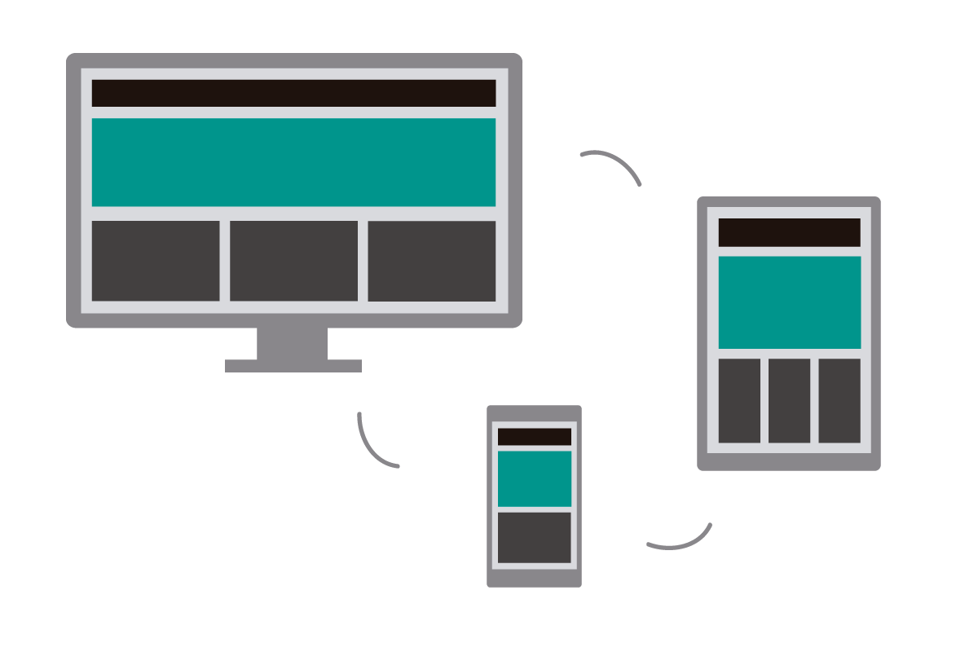
What is Responsive Web Design?
A web page that “responds to” or resizes itself depending on the type of device.
It’s like having one site that responds differently on different devices.
It uses both relative units and media queries, combining the ideas of a liquid layout and an adaptive layout.
This approach uses flexible layouts, flexible images and media queries.
The goal is to detect user’s screen size and orientation, and change the layout accordingly.
Notes:
Example link:- https://codepen.io/nickpettit/full/rLlaF

Slide 12
Let’s see some examples!
Example Link

Slide 13
Media Queries
Media Query is a CSS3 module that allows the content of the web page to adapt to the type of media, it is rendered in.
It consists of media type along with one or more expressions.The logical expressions can be true or false.
It uses the @media rule to include a block of CSS properties only if a certain condition is true.
Media types:
all - print
screen - speech
Used to check:
Width and height of viewport
Width and height of device
Orientation (landscape or portrait)
Resolution

Slide 14
Syntax
Combines media feature with media types or other media features.
Reverts the meaning of media query
@media not|only mediatype and (mediafeature and|or|not mediafeature) {
CSS-Code;
}
Prevents older browsers (which does not support media queries) to apply the media features. Doesn’t affect modern browsers.
Rule used to add different styles for different media types/devices.
Comma separated. Treated like two separate media queries
Notes:
https://stackoverflow.com/questions/9286325/what-exactly-does-the-only-keyword-do-in-css-media-queries
https://www.w3schools.com/code/tryit.asp?filename=G1L1PYKO5F0X

Slide 15
Breakpoint
It’s the point at which your sites’ content will respond to provide the user with the best possible layout to consume the information.
Major breakpoint in web design is kept to a minimum.
It should be required only when the number of columns in the layout needs to change.
Commonly used device breakpoints:
320px
480px
768px
1024px

Slide 16
Exercise
Implement the given design and make it responsive.

Slide 17
Thank You !!!

